Slide 1
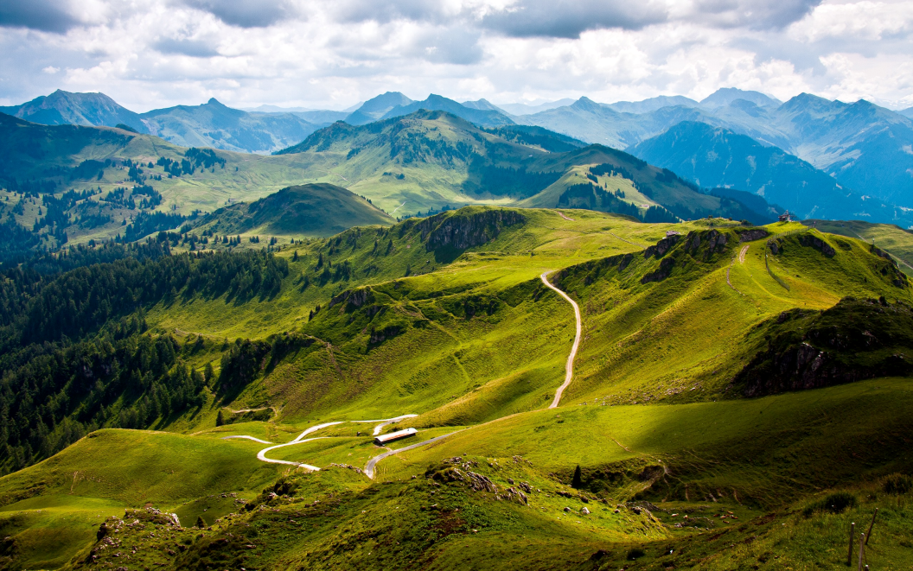
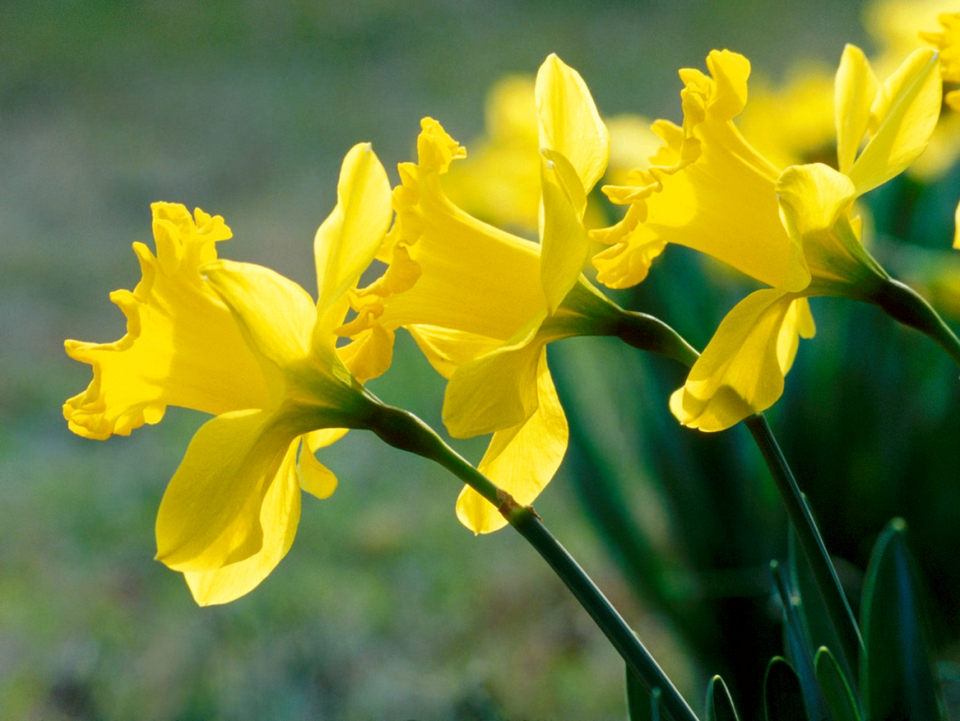
I Like The Flowers
Tekst: Vamp
I like the flowers
I love the daffodils
I like the mountains
I love the rolling hills
I like the fireside
When the lights are low
Boom de-ah-da, Boom de-ah-da
Boom de-ah-da, Boom

